Slide 1
StreetSmart
by team BruhMoment

Slide 2
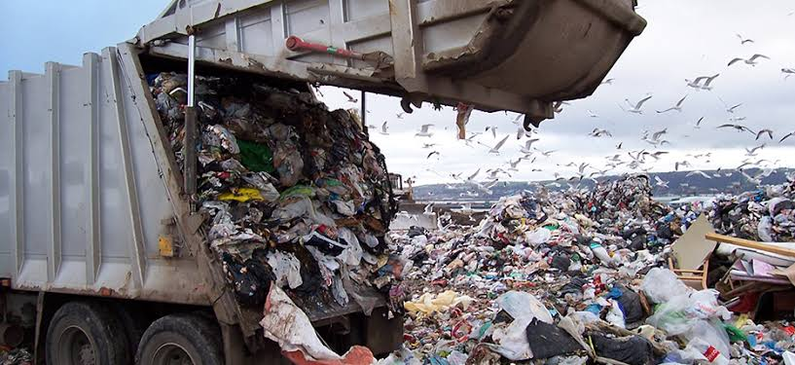
Problem Statement
It is a well known fact that garbage and related(potholes,open sewers) problems are a huge nuisance but there exists no correct measures to analyse these situations and approach them in a suitable manner. There is no proper Data measure to correctly assess these situations.Likewise,there is no ability to know the intensity of these different types of garbages

Slide 3
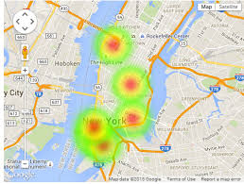
Approach to tackle the problem
Giving the users a proper platform to upload the database of these known but non manageable problems
The data from the users will be presented in form of a HEATMAP which allows to see the INTENSITY and PRIORITY of the garbage(or others) situation.

Slide 4
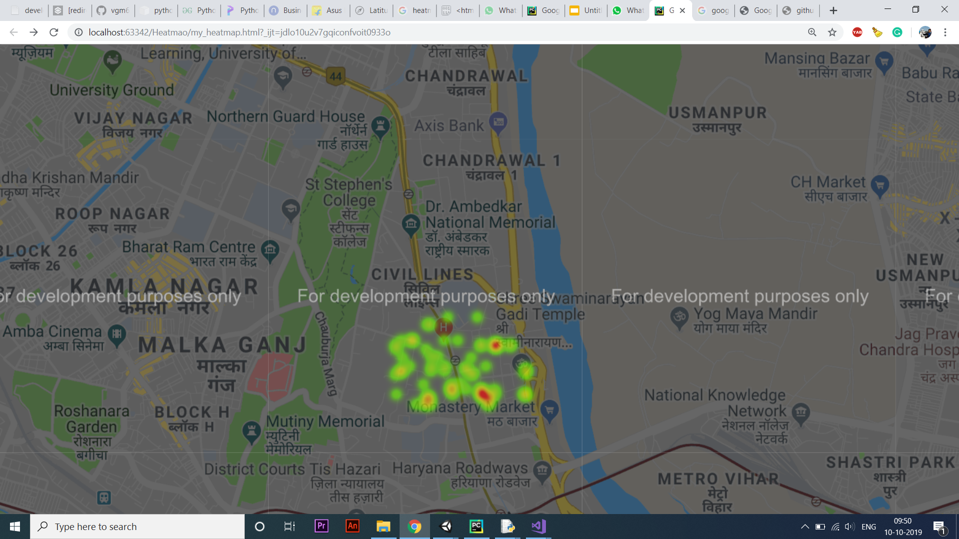
Garbage areas near Kashmere Gate region on basis of Garbage Intensity and People response

Slide 5
Benefits of HEATMAP
1)Constant Real time updates of different types of problems like Potholes,Garbage Dumps,Open Sewers
2)Intensity of each type of problem is depicted by the intensity of the HEATMAPs
3)Allows people/organizations to monitor the problems by seeing the total duration the problems have existed and take appropriate action on them
4)Prioritize the different type of problems by graphical means

Slide 6
What it can detect?
1)GARBAGE DUMPS:Uses Location based image capture and Machine learning algorithm to determine intensity
2)POTHOLES: Requires hardware combination of accelerometer and gyroscope.Computer Vision can also be used
3)OPEN SEWERS(FUTURE SCOPE)

Slide 7
Features
1)MACHINE LEARNING ALGORITHMS: Used to identify the different types of Garbage Intensities.CNN used to differ between different types of Garbage
2)REWARD SYSTEM:Used to encourage users to participate more and fill the heatmap database
3)Route Tracking:Allows the authorities to properly track high priority zones
4)Data from each location available to the users

Slide 8
REWARD SYSTEM
The reward system will enforce people to click more photos of actual garbage sites by providing them points for a particular number of pictures.
Later they can cash in their points for actual money value

Slide 9
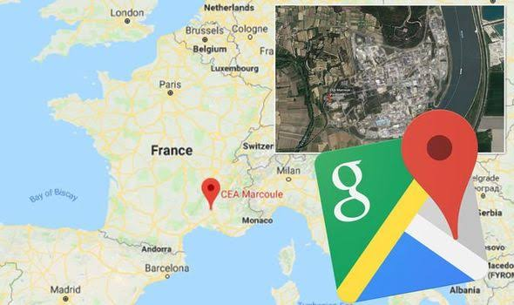
Technological Stack
1)Python
2)Google Maps
3)Firebase
2)TensorFlow
3)Android Studio
4)JavaScript

